Slide 1
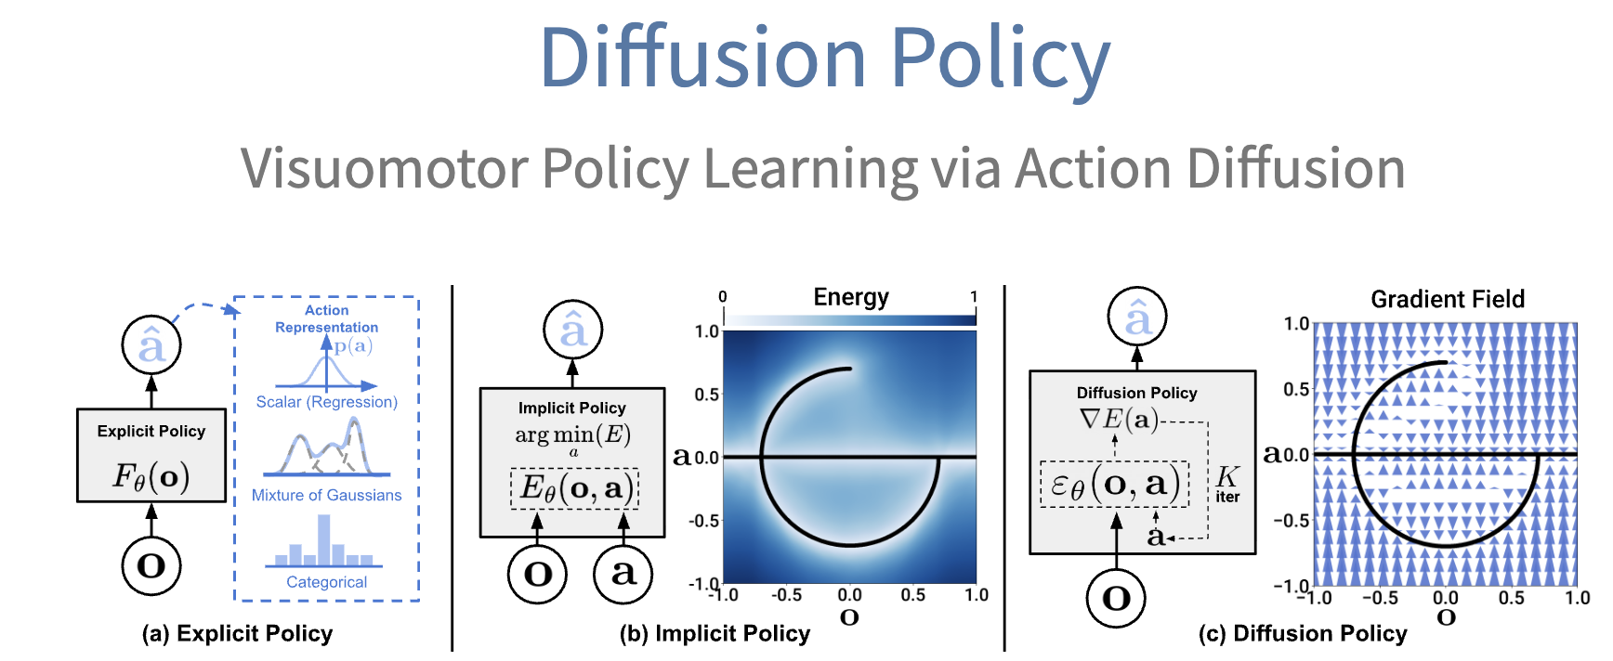
2D Policy Learning
2D Policy (e.g., Diffusion Policy ^{[1]} )
[1] Diffusion policy: Visuomotor policy learning via action diffusion.
Notes:
Recent Advancements in VLA has demonstrated scaling effect in 2D policy learning

Slide 2
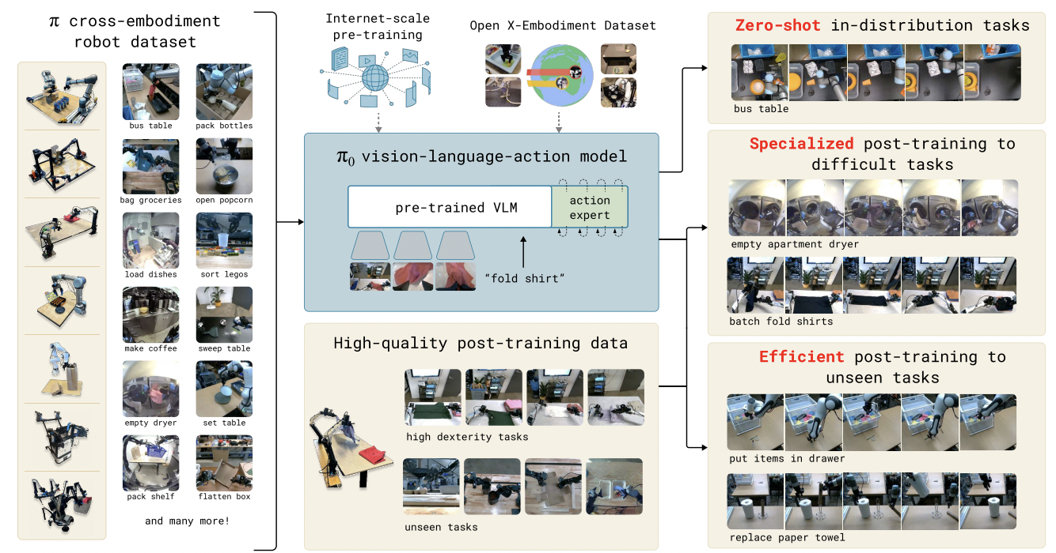


2D Policy Learning
Scaling
2D Policy (e.g., Diffusion Policy ^{[1]} )
2D VLA (e.g., $π$0 ^{[2]})
Scaled-up Data
Scaled-up Architecture
[1] Diffusion policy: Visuomotor policy learning via action diffusion.
[2] $π$0: A Vision-Language-Action Flow Model for General Robot Control.
Notes:
Recent Advancements in VLA has demonstrated scaling effect in 2D policy learning

Slide 3
2D Policy Learning
How to Scale 3D Policy Learning?
Notes:
However, the well-known 3D policy like DP3 shows using larger encoder is harmful

Slide 4
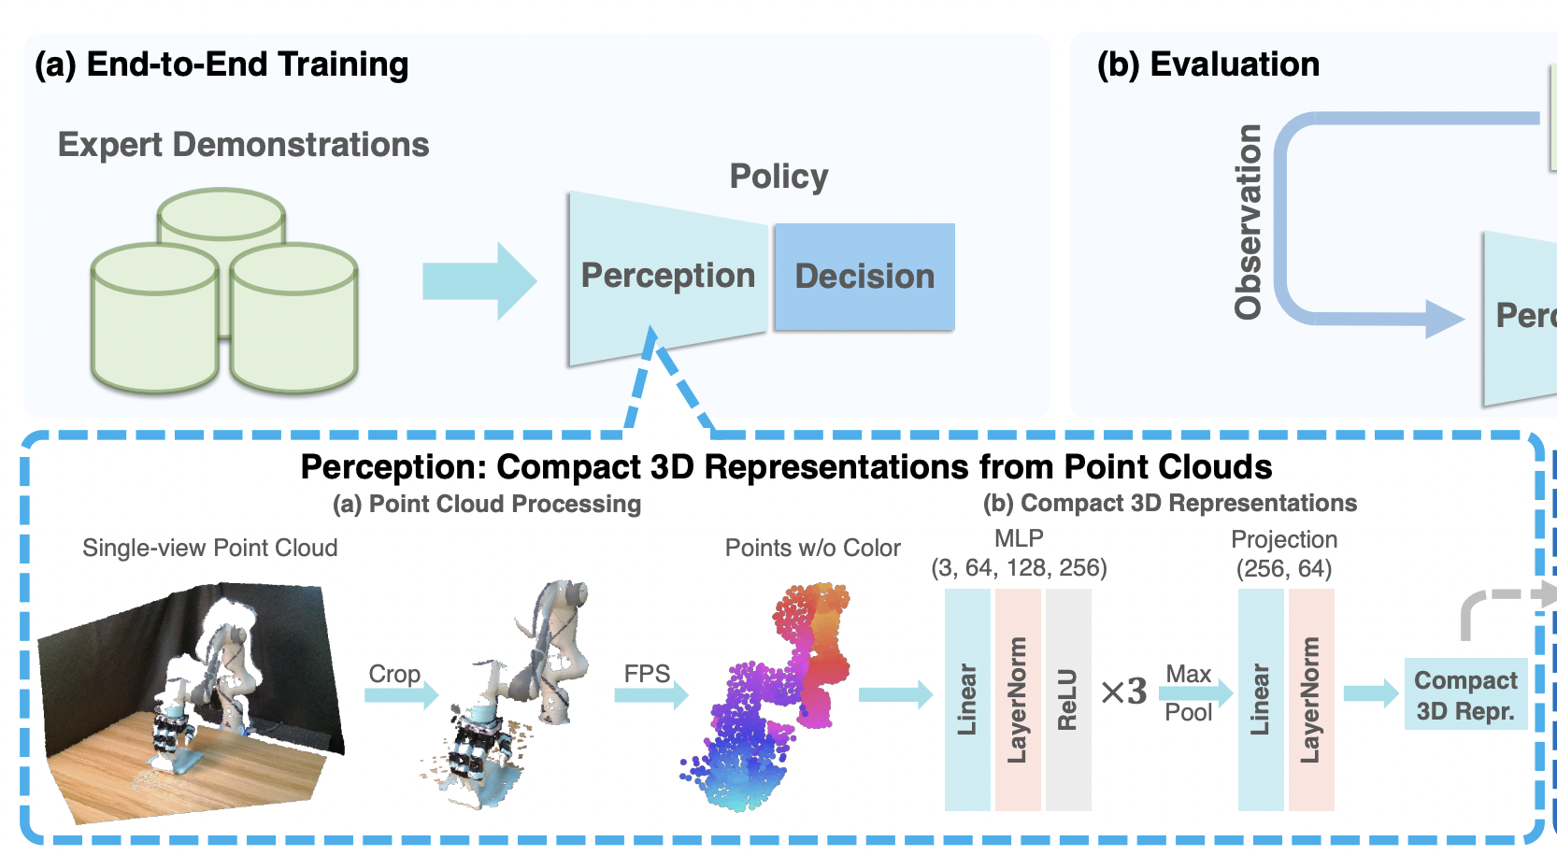
How to Scale 3D Policy Learning?
3D Policy (e.g., DP3 ^{[1]} )
[1] 3D Diffusion Policy: Generalizable Visuomotor Policy Learning via Simple 3D Representations
Notes:
However, the well-known 3D policy like DP3 shows using larger encoder is harmful

Slide 5
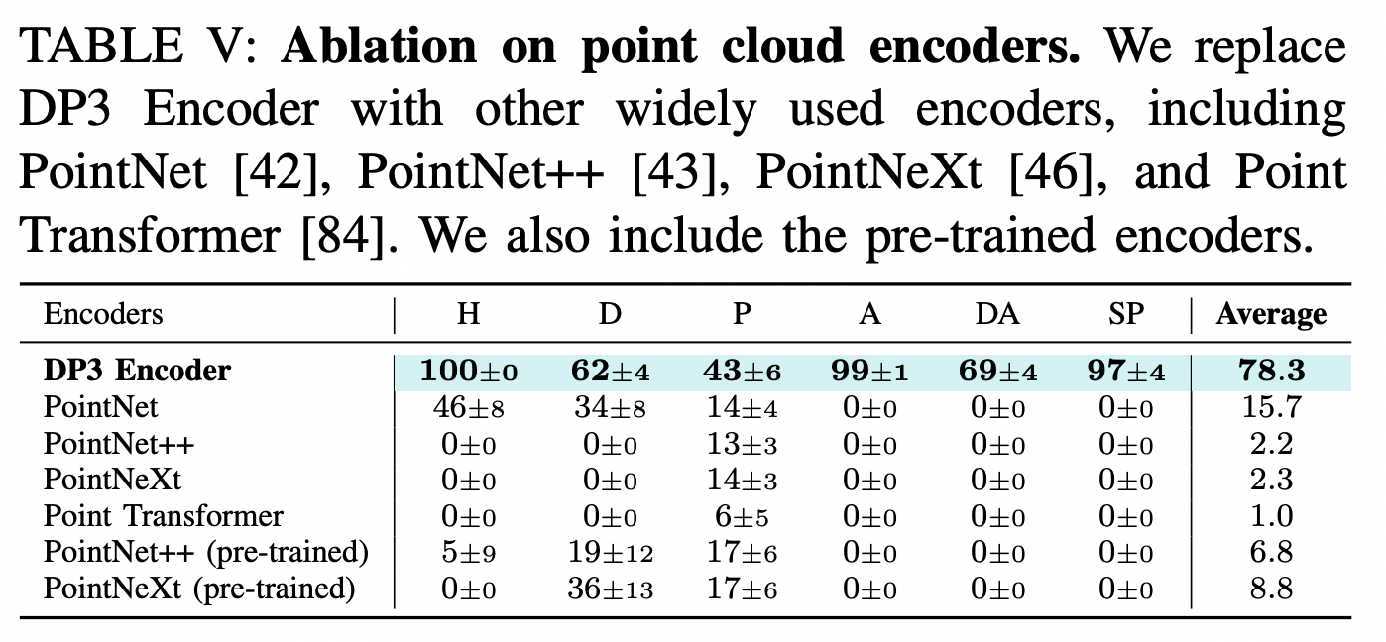

How to Scale 3D Policy Learning?
Scaling?
3D Policy (e.g., DP3 ^{[1]} )
DP3 ^{[1]} uses a tiny PointNet encoder
and scaling up to larger encoders is harmful
Can’t scale up encoder
[1] 3D Diffusion Policy: Generalizable Visuomotor Policy Learning via Simple 3D Representations
Notes:
However, the well-known 3D policy like DP3 shows using larger encoder is harmful

Slide 6

















Global Observation ${\tilde{O}}_{t}$
How to Scale 3D Policy Learning?
$$P_{t}^{′}$$
$$q_{t}$$
$$k$$
Linear
FiLM
Linear
$$β$$
$$γ$$
$$β$$
$$γ$$
$$a_{J}^{k}$$
$$a_{J}^{k−1}$$
$x$: Action Emb
$$β • x +γ$$
$x$: Action Emb
$$β • x +γ$$
Scaling?
…
Conv1D
Conv1D
Conv1D
Conv1D
Conv1D
$$a_{EE}^{k}$$
$$a_{EE}^{k−1}$$
3D Policy (e.g., 3D Diffusion Policy ^{[1]} )
x$K$
Film-based global feature conditioning diffusion (DP3 ^{[1]})
Can’t scale up encoder
Can’t scale up decoder
[1] 3D Diffusion Policy: Generalizable Visuomotor Policy Learning via Simple 3D Representations
Notes:
Besides, the Film-based global feature conditioning diffusion constrains the scaling up of its decoder

